Slide 1
Securing the Public Cloud
Optimizing security and compliance posture, knowing which cloud platform service alerts to prioritize, keeping data secure and private, and blocking advanced threats are high priorities for all organizations, but can be hard to achieve with specialist cloud provider platform skills.
Through the session we’ll talk about what we're seeing at Sophos in the security landscape as more organizations move to cloud, sharing with you how many of our customers are responding to these shifts, the best practices they are adopting in products and protection, and how you can best leverage cloud security posture management tools available from Sophos to secure your cloud environments and close the skill gap.

Slide 2
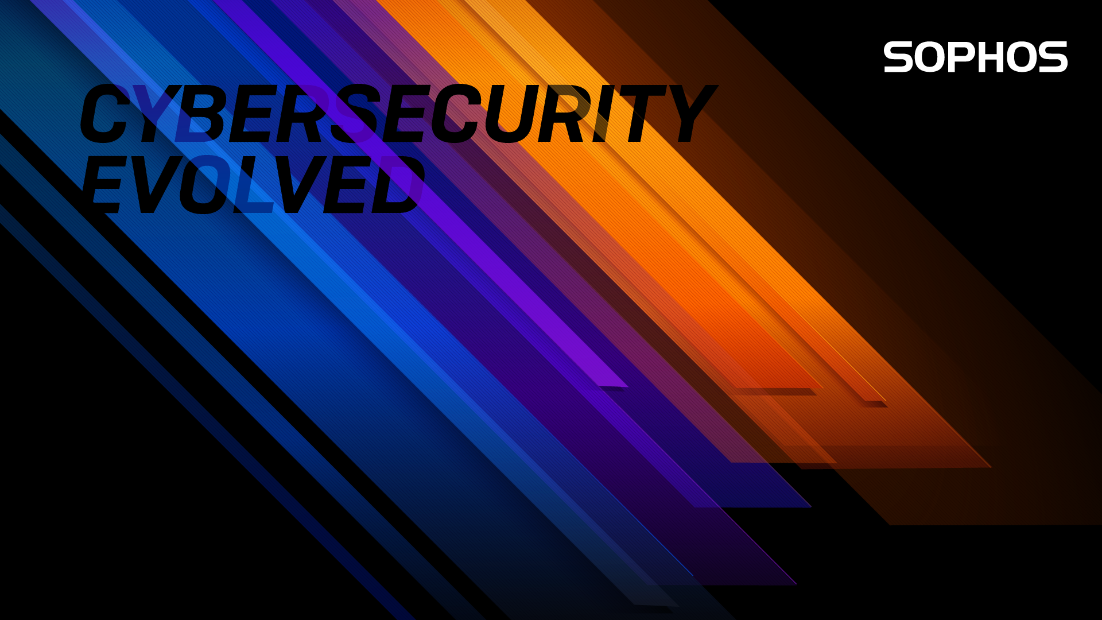
Securing the Public Cloud with Sophos
Richard Beckett
Sophos Senior Product Marketing Manager

Slide 3
Securing the Public Cloud with Sophos
Richard Beckett
Sophos Senior Product Marketing Manager
Notes:
Hello everyone and welcome to this session on Securing the Public Cloud with Sophos today.
Through the session I’ll talk about what we're seeing at Sophos in the security landscape as more organizations move to cloud,
And share with you how many of our customers are responding to these shifts, the best practices they are adopting in products and protection, and how you can best leverage cloud security posture management tools available from us to secure your cloud environments.

Slide 4
Cloud Security is a Shared Responsibility
Responsibility
SaaS
PaaS
IaaS
On-Prem
Regardless of the type of deployment, the following responsibilities are always retained by the customer:
Data
Endpoints
Account
Access management
Customer data
Devices (Mobile, Macs, and PCs)
Accounts and identity access management
Identity and directory infrastructure
Applications
Network and firewall configuration
Operating System
Physical Hosts
Physical Network
Physical Datacenter
Notes:
And to begin we must touch on the shared responsibility model and your role in securing cloud workloads and data.
As you move to cloud it’s important to take the time and understand your cloud providers own model, today we’ll be discussing IaaS (so from a Sophos perspective - AWS, Azure, and Google Cloud Platform primarily).
The simplest way to think of it is that you’ll inherit the physical datacenter security from these providers, but you still need must secure everything you run in the cloud.

Slide 5


The Shifting Landscape for Security Teams
BUSINESS SHIFT
ENVIRONMENT SHIFT
Cloud migration of
apps and data
Remote working environments
Improved performance
and scalability
Dispersed across multiple
accounts
Highly dynamic environments
Changes introduced from
across the organization
Notes:
Now, lets look at the shifts occurring in the cloud
First, the Business Shift going on here…
In the constant search for ways to improve productivity and efficiency, Cloud is a great enabler in that shift.
Efficiencies are realized through the migration of data and applications to the cloud—benefits like the ability to work from anywhere, lower costs of operation, and improved performance and scalability.
But the environment shift can make it hard for security to keep up
As you expand into the cloud, you also generate a growing attack surface with multi-cloud environments, containers, and serverless. Dynamic, elastic environments that can change daily, even hourly making it hard to understand what you have running​. And new ways that software and supporting infrastructure can be created– with methodologies like DevOps meaning cloud services and infrastructure can be created and configured without the security team's knowledge.

Slide 6

Attacker Shift to Configuration Vulnerabilities
66% of attacks take advantage of misconfigurations
Frankfurt
1:04:15
Ohio
0:04:46
California
0:14:14
Singapore
0:49:37
Sao Palo
0:00:52
Virtual machines with SSH exposed – Time to first brute-force login attempt
Source [66% of attacks]: Sophos State of Cloud Security 2020.
Source [Time to first login attempt]: Exposed: Cyberattacks on Cloud Honeypots.
Notes:
Couple this with the attacker shift to automated attacks targeting cloud resource misconfigurations, and you start to see the challenge that the speed, and agility of the cloud can create for security teams.
You can see here how quickly attackers can identify your weak points from our recent SophosLabs research project, demonstrating that attackers are automating searches for misconfigurations, such as leaving SSH exposed in this case, and those gaps in security can be found in less that a minute!
So, the threat is very real and your window to respond is short.

Slide 7

Priorities for IT Security
INCREASE SECURITY SPEED AND AGILITY
Consistent visibility and management
Risk prioritization of alerts with
automated and guided remediation
Identification of critical weak signals before
they become strong signals
Notes:
But, there are no headlines for the businesses that successfully defend themselves against thousands of breach attempts every day. And this is largely due to significant improvements in cybersecurity. How it can be the enabler for cloud transformation, supporting your teams to go faster, and match the agility of cloud services and the methodologies you adopt.
To release your team from the biggest challenges affecting their ability to go fast – think about
Visibility - Having tools that make it possible to view security posture across multi-cloud environments and accounts, is a huge saving – not just in response time, but in staff training and onboarding time.
Close the skills gap – while cloud provider platform services are helpful, cloud environments have the potential to become very noisy. Tools that help identify the critical alerts and either provide detailed guidance to fix issues, or automatically provide protection are keys to agility.
And think about how you’ll identify the weak signals – as attackers move to hands-on-keyboard, IT security needs to do the same to hunt and detect suspicious behavior and events before they become a breach.

Slide 8
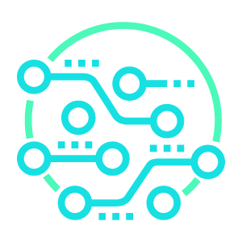

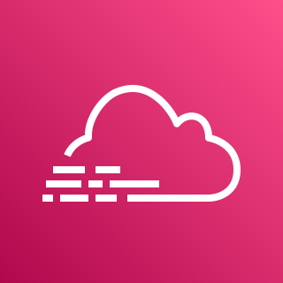
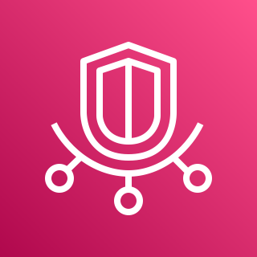
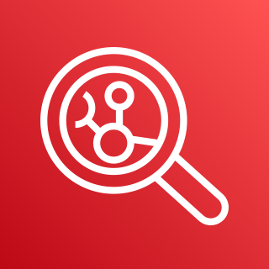



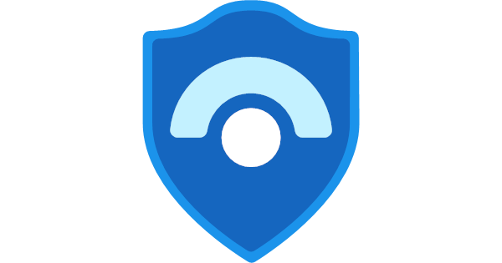
Successful, Secure and Scalable Cloud Transformations
Comprehensive approach to increase security speed and agility
CLOUD SECURITY
POSTURE
MANAGEMENT
Sophos Cloud Optix
Discover cloud resources and identify weaknesses in configuration
Agentless SaaS services for single and multiple cloud environments
Virtual machines
Containers
Serverless
Storage
Virtual Network
IAM
Infrastructure as Code
Spend Monitoring
Amazon
GuardDuty
AWS
CloudTrail
AWS Trusted Advisor
Amazon Inspector
Amazon Detective
IAM Access Analyzer
Azure Advisor
Azure sentinel
Notes:
To build a secure and scalable base for you cloud transformation, our approach is to…
Get the basics right, and that starts with comprehensive visibility. Organizations need to gain full visibility into what resources are being added, changed, or removed to help reduce business risk created through resource misconfigurations and security vulnerabilities.
To do that, adopt a security monitoring tool to identify weaknesses in configuration and make Cloud Security Posture Management a key priority in your cloud journey. And for Sophos this is through Cloud Optix – which we’ll expand on later in todays session.

Slide 9
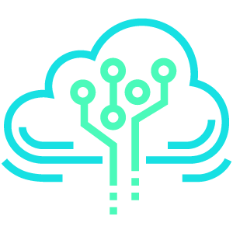
Automate Protection of Workloads and Data
Cloud Workload Protection
CLOUD SECURITY
POSTURE
MANAGEMENT
Cloud WORKLOAD
PROTECTION
Sophos Cloud Optix
Discover cloud resources and identify weaknesses in configuration
Intercept X for Server
Advanced threat protection
across endpoints, cloud
workloads and data
Anti-virus and anti-malware agents
Next-gen firewalls
Endpoints
Virtual desktops
Virtual machines
Servers
Notes:
Automation of cloud workload protection agents like Sophos Intercept X for Server are also key elements to consider.
Malware and ransomware are just as prevalent in the cloud as on-premises, with 59% of attacks where the data was encrypted now involving data in the public cloud. So, the need for antivirus, with protection from malware, ransomware and exploits are just as crucial in the cloud.
But an important area of planning here is also to review what workloads will move to the cloud and when.
As you shift resources, or deploy new cloud server wokloads to support remote working, look out for how portable your protection is – can it move from on-prem to cloud, and can you manage it from the same console, or without learning new tools? With Sophos you can.
Thinking this through will ensure the best ROI when planning cloud migrations, and reduce the resource impact on your IT security team.

Slide 10
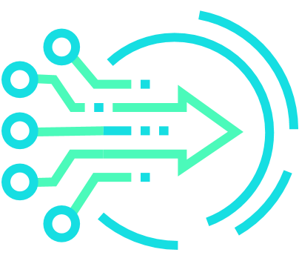
Identify Critical Weak Signals of Attacker Behavior
Managed Threat Response
CLOUD SECURITY
POSTURE
MANAGEMENT
Cloud WORKLOAD
PROTECTION
MANAGED THREAT RESPONSE
Sophos Cloud Optix
Discover cloud resources and identify weaknesses in configuration
Intercept X for Server
Advanced threat protection
across endpoints, cloud
workloads and data
Sophos MTR
24/7 proactive threat
prevention, detection
and Response
Fully managed services to hunt for and respond to potential threats and suspicious behavior
Fully managed service to hunt for and respond to potential threats and suspicious behavior
Endpoints
Virtual machines
Servers
Cloud configurations and anomalies
Notes:
And use an EDR/XDR services to identify threats across the environment, and a Managed Threat Response service overlay. To make sure you're looking for weak but critical signals that may be early indicators of a breach.
Automated protection is crucial, but as attackers increasingly move to stealthy approaches to compromise systems, organizations need to identify the breadcrumbs, the critical weak signals of attacker behavior within your environment, before they become strong signals, and it’s too late.
The challenges presented by time and resource availability can make it impossible for organizations to carry out the 24/7 monitoring, and this is where the Sophos Managed Threat Response service comes into play. Where our dedicated teams of threat experts proactively hunt for potential threats and suspicious behavior that could lead to a serious security breach.

Slide 11
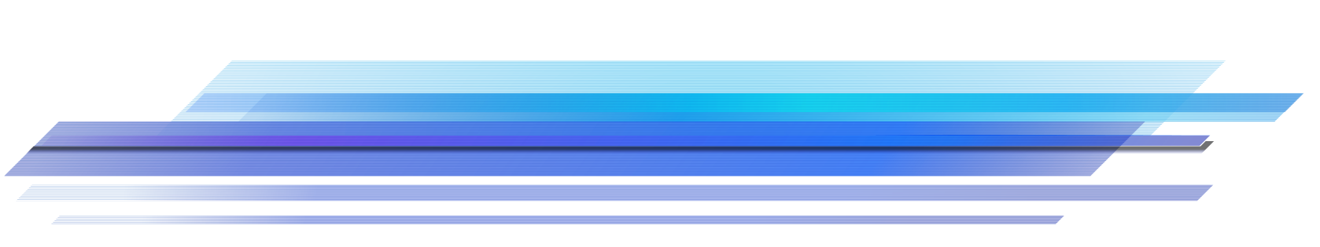
Start with Visibility
Notes:
So that is our headline recommended approach to securing your cloud environment with Sophos and Switchpoint.
But , today we’ll focus on Cloud Security Posture management, and Sophos Cloud Optix, as it gives your team the visibility needed to see what you’re running in the cloud, where you have vulnerabilities that might be exploited, and how to fix them.

Slide 12
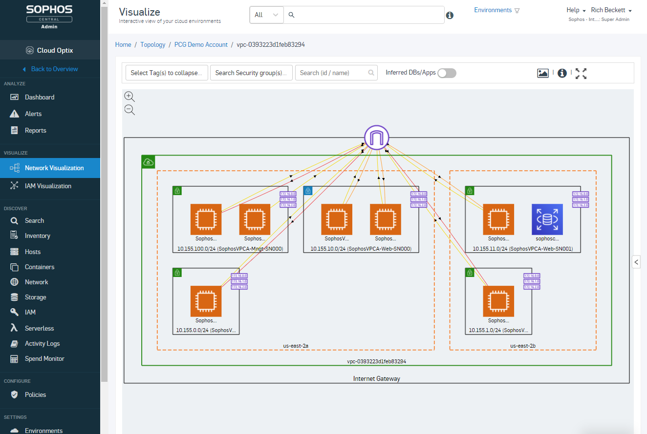
Sophos Cloud Optix
Cloud Security Posture Management
Risk-based prioritization of security issues with guided remediation.
Asset and network traffic visibility for cloud environments.
Continually analyze for security and compliance risks, over-privileged IAM access and spend anomalies.
Integrate security checks at any stage of the development pipeline.
Optimize multi-cloud spend on a single screen.
Notes:
Cloud security posture management tools are here to combine and extend cloud provider services into a single interface across multi-cloud environments.
At it’s core it’s identifying and risk-profiling these security, compliance, and cloud spend alerts. And it provides contextual alerts that group affected resources with detailed remediation steps, plus auto-remediation where appropriate.
(Click)
Sophos Cloud Optix provides complete visibility of an organizations cloud assets. Allowing teams to view accurate inventories and generate on-demand topology visualization – saving hours, if not days of time for busy teams
(Click)
Continually analyzing cloud environments for security risks including insecure cloud configurations and deployments such as unrestricted access from the internet, open ports, and unencrypted data that could create a breach point. As well as user access anomalies to cloud provider management consoles, and over privileged Identity Access Management roles, and compliance policy failures.
(Click)
And it does all of this from the development cycle through to the ongoing security of live cloud services, ensuring security misconfigurations are never released into a live environment where an attacker could use them to compromise systems.
(Click)
And it extends checks beyond security and compliance, Cloud Optix also helps organizations to optimize AWS and Azure service costs. Tracking cloud costs for multiple services side by side on a single screen to improve visibility and reduce wasted spend.

Slide 13
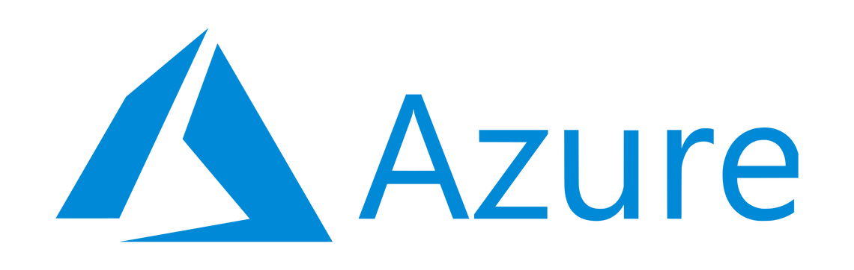


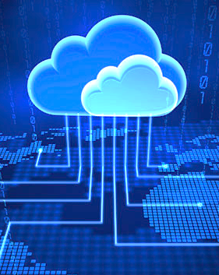
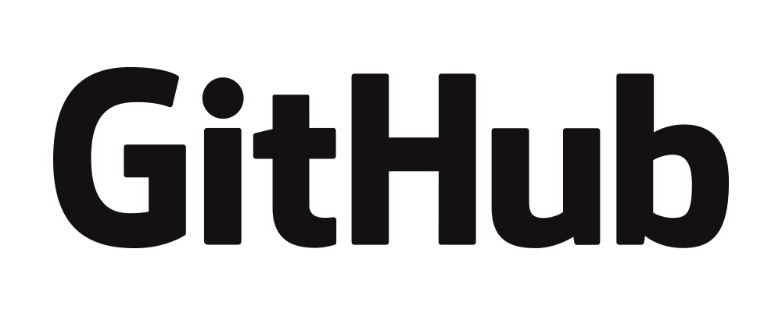
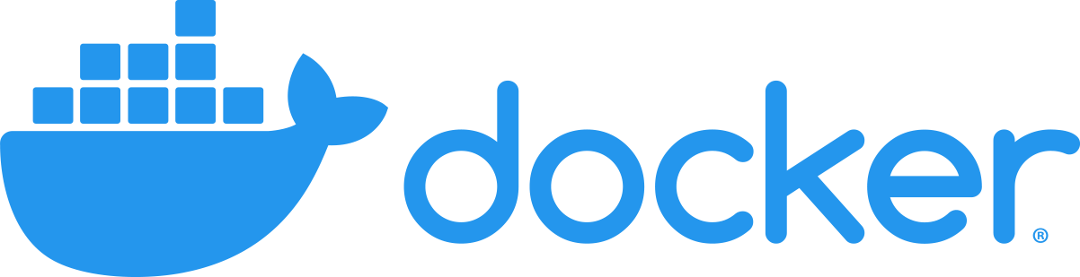
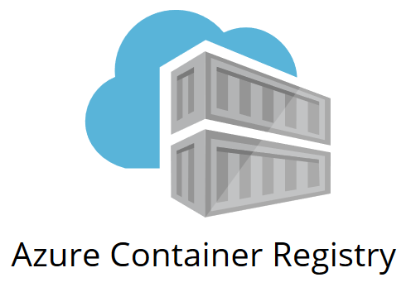
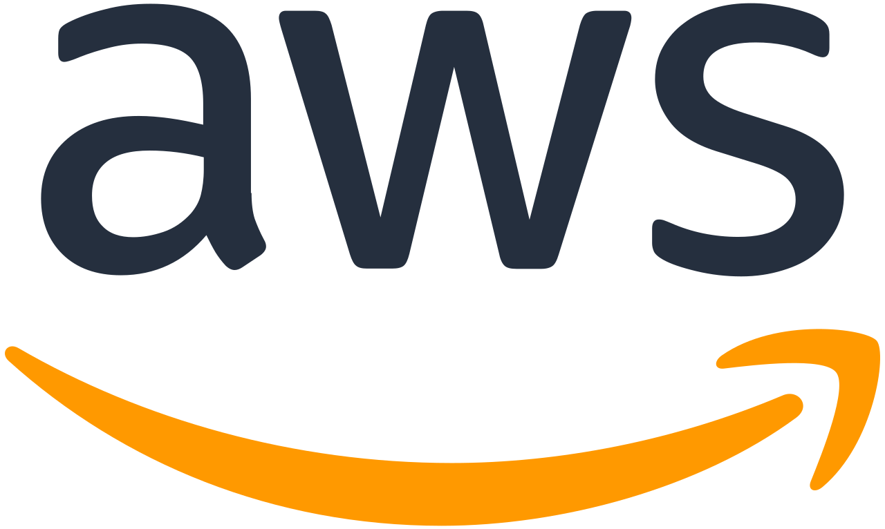
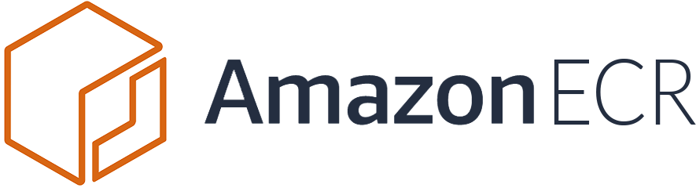
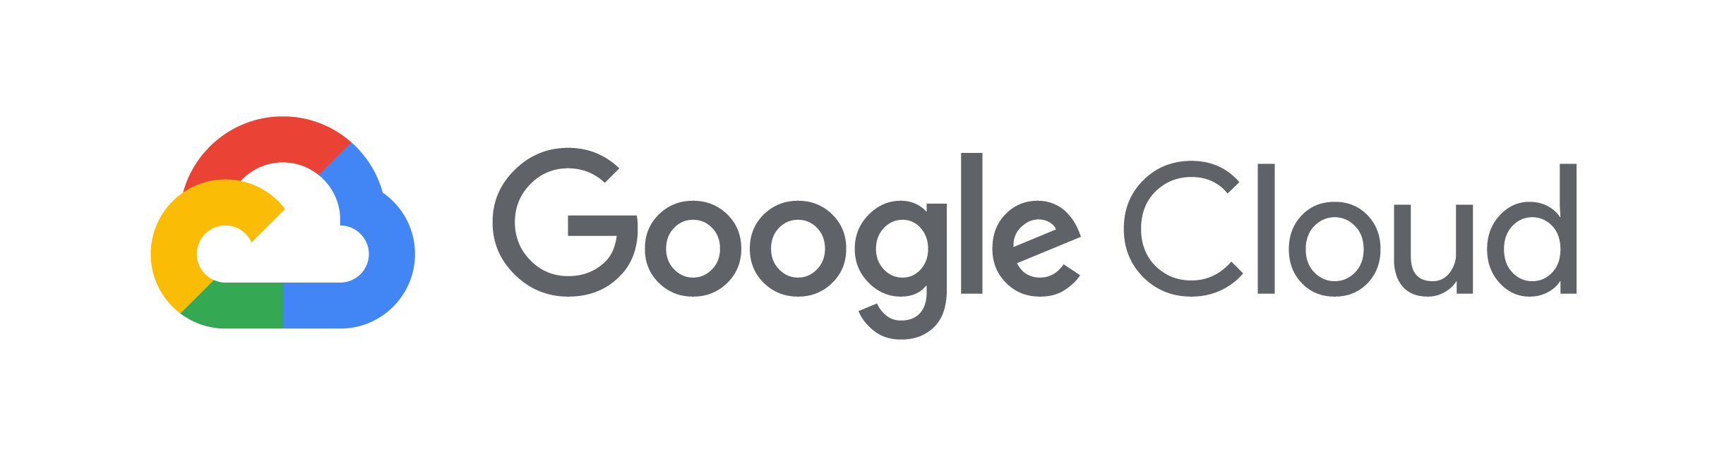
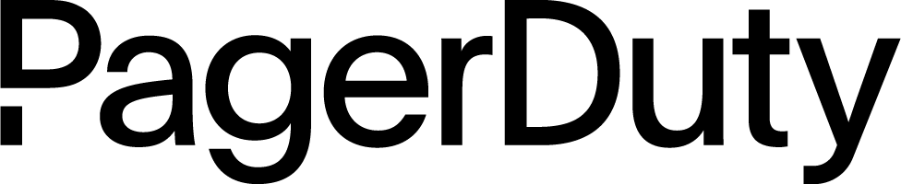
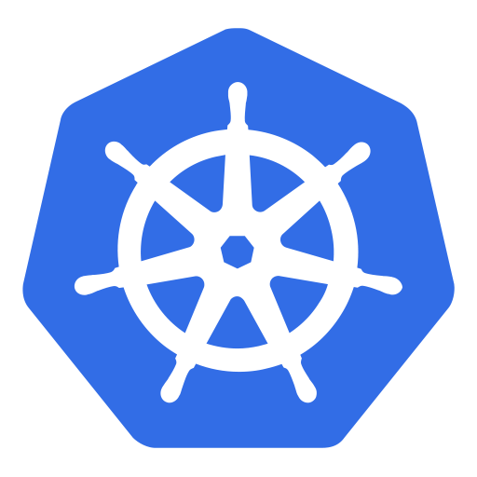
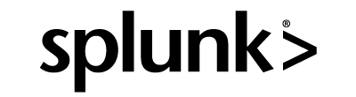
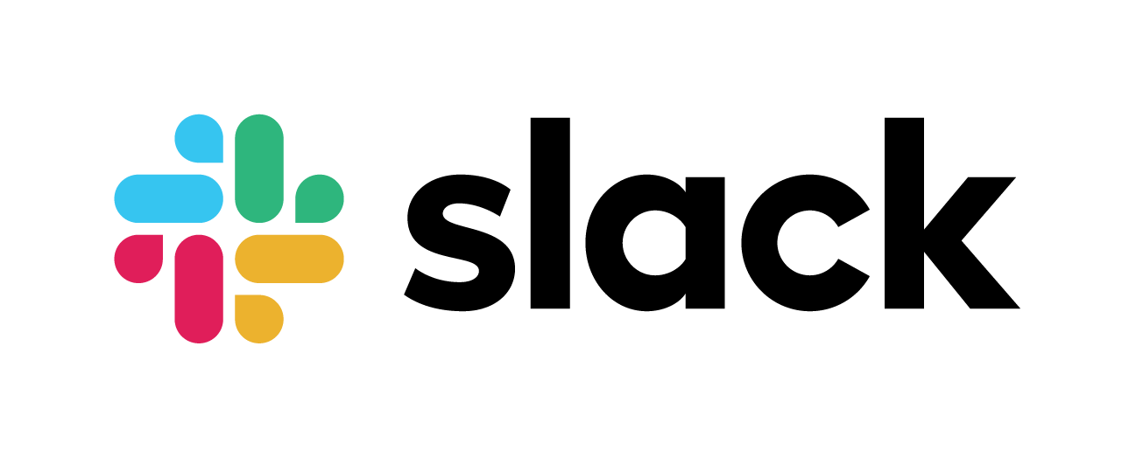

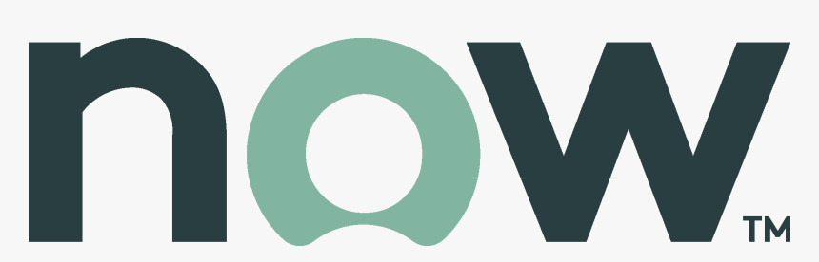
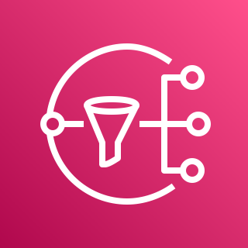
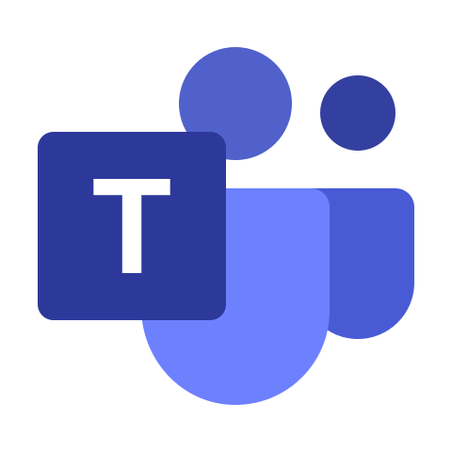
Detect and Prevent Cloud Infrastructure Vulnerabilities
Enable traceability
ENVIRONMENTS
CLOUD SECURITY POSTURE MANAGEMENT
INTEGRATIONS
Automate build pipeline security
DevOps and
Infrastructure Automation
Automate security best practices
Continually assess compliance status
Security Operations, Ticketing, and Collaboration
Notes:
To match the speed of automated attacker searches, we want to enable you to automate the identification of vulnerabilities and remediation as much as possible.
So, we use AI to enable traceability of unusual user access, api calls, and changes in configuration
We inject security at all layers of development - with integration of security checks within the development pipeline to identify security vulnerabilities in IAC templates that automate the deployment of new infrastructure as well as scanning Container images for OS vulnerabilities.
Automate security best practices by mapping your infrastructure automatically to compliance and security best practices. With policies to make sense of the requirements of each standard with reports to identify any areas that need attention, and guardrails to automatically prevent changes to critical settings from happening in the first place.
And then continually monitor those configurations to ensure you stay in compliance, and any misconfigured changes introduce to the platform can be identified and fixed quickly.

Slide 14
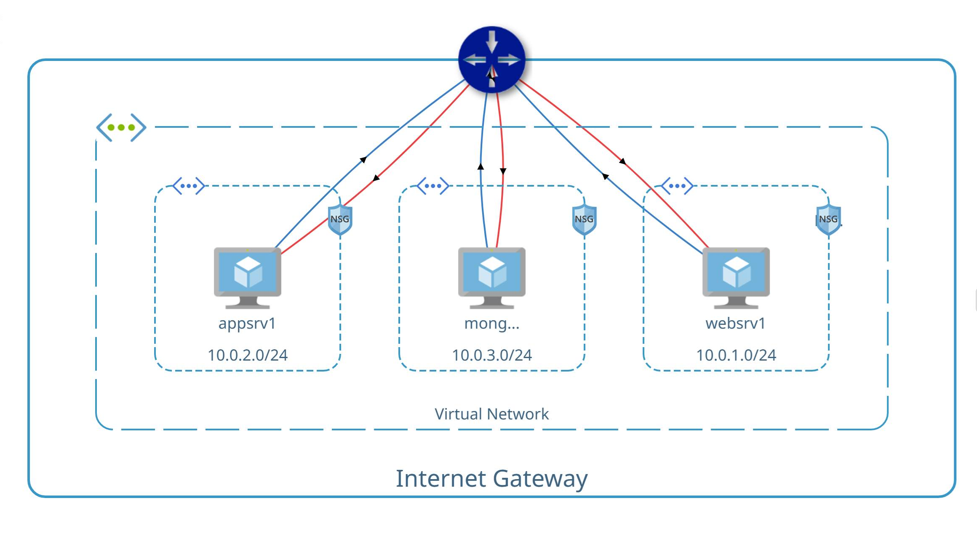
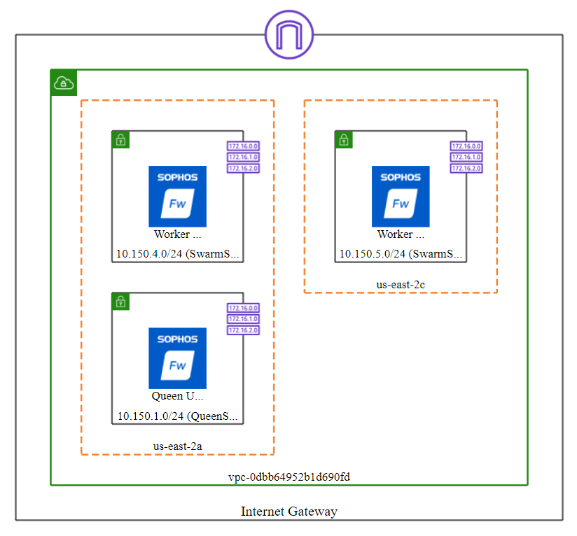
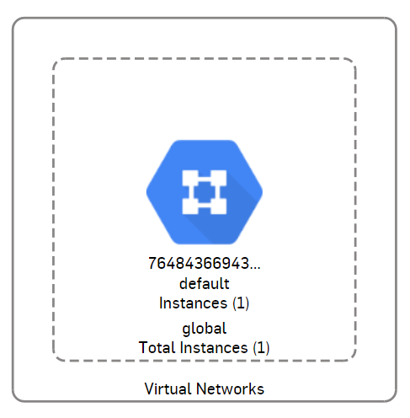
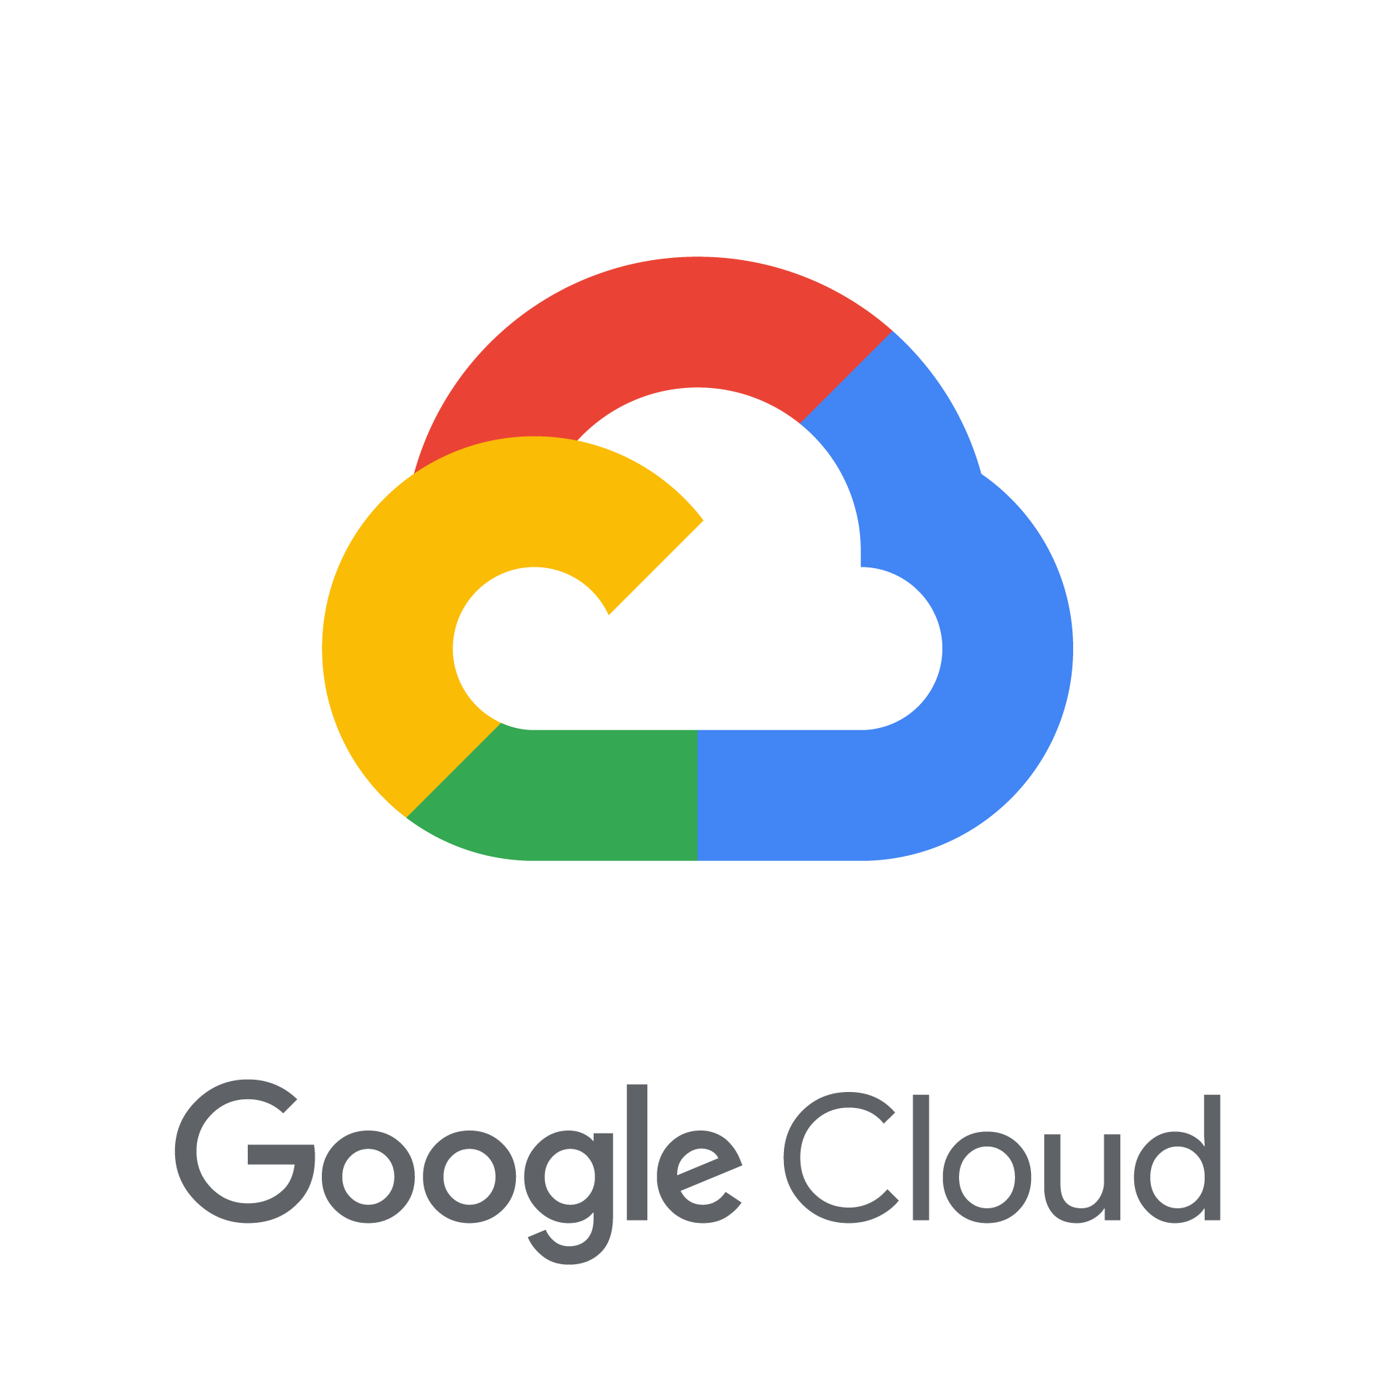
Visualise hidden Security Threats
Automate network visualization
Identify, group, and prioritize risks
Employ a range of remediation tools
Notes:
Taking visibility very literally for a moment, Cloud Optix enables organizations to also reliably see what they had running.
With real time snap shots of hosts, containers, networks, user accounts, storage services and so on. Automatically creating accurate network diagram to save the hours of time
And to allowed teams to see how those resources are connected and how traffic flows between them, using IA to identify unusual behavior such as exfiltration of data.
And going further to show how traffic might flow based on your Security Group settings. This is really important, because you may not realize that access to or from the Public Internet is allowed for key resources such as databases – a major cause of company breaches, and also a major source of compliance failures

Slide 15

Automate and Simplify Security Controls
“
“
Automate network and visualization
Cloud Optix makes it easy for us to check activity and proactively prevent risks as needed, so our employees can use cloud resources flexibly and safely.”
Identify, group, and prioritize risks
Jan Van Moere, Network & Security Engineer at Niko
Employ a range of remediation tools
Notes:
Next – smart alerts consolidate alerts across cloud providers and identify unusual behavior that humans could miss in isolation.
This automated detection and prioritization of deviations in security posture, was particularly crucial for our customer, Niko when monitoring employee access to cloud environments. The benefit for them is they now only have to monitor the flagged deviations in the Cloud Optix dashboard in order to safeguard the current level of security, and their employees can continue to use AWS and Microsoft Azure cloud resources flexibly and safely.

Slide 16




Automate and simplify security controls
Automate network and visualization
Identify, group, and prioritize risks
Ticket
Remediate
Suppress
Employ a range of remediation tools
Notes:
What ties all this together is better collaboration between teams and better remediation tools. Making it simple fix issues affecting their security and compliance status quickly.
Integrations with third party ticketing services that make collaboration much easier between the various Development, Security, and Operations teams involved in fixing compliance and security alert issues. For instances, integrating directly with tools like Jira and ServiceNow, with alert information that can be used to create tickets within the console - ensuring important tasks were never lost, even during a release.
And importantly, tools that open up auto-remediation capabilities. And after speaking with our customers we’ve developed webhook integrations – allowing the customer to define remediation outcome, and retain write access to their environments
Allowing you to suppress alerts if needed – until the start of the new development sprint when resources become available for instance – suppress down to individual resources, not entire rule

Slide 17
Wipe Out Avoidable Breaches
Notes:
And all this makes it possible to wipe out a range of avoidable security weaknesses and potential security breach points when Cloud Optix is actively managed.

Slide 18


Wiping out Avoidable Breaches
1
Exposing Remote Desktop Protocol (RDP)
89% of Organizations
2
Overprivileged
IAM roles
91% of Organizations
Data Storage Misconfigurations
64% of Organizations
3
Notes:
And to help bring this to life, I’ll cover these top three potential breach points - from low hanging fruit, to more advanced areas.
As in a review of all newly onboarded customers to the Cloud Optix service these were the most worrying trends in organizations’ security posture.
From exposing RDP, to creating access roles with excessive privileges that could be exploited, and misconfiguration of data storage – from unencrypted databases, through to shared storage or hard drive snapshots with public access.
But all can be wiped out…….lets take a look at how you would identify and remediate these vulnerabilities with a brief demo of Cloud Optix.

Slide 19
Cloud Optix Demo
Notes:
And all this makes it possible to wipe out a range of avoidable security weaknesses and potential breach points when Cloud Optix is actively managed.

Slide 21
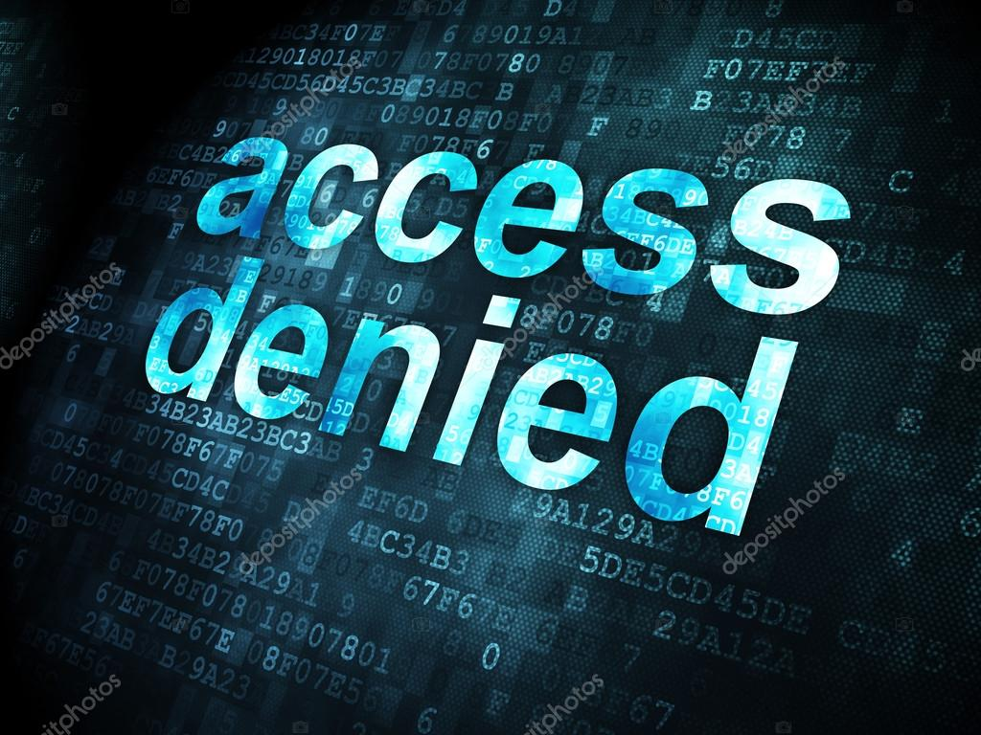
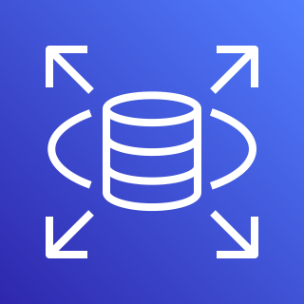
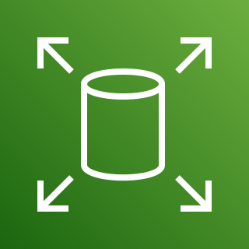
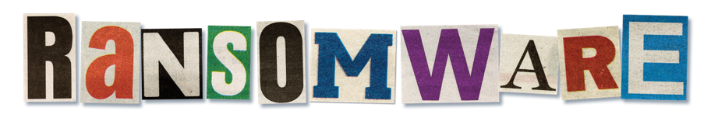




Protect Cloud Data and Shared Storage
Unauthorized Access Protect and monitor AWS environments for unauthorized user access events.
Cloud Storage Services
Automatically discover storage services and access security configurations
Anti-Ransomware
Stops ransomware and automatically rolls back any changes to prevent data loss
Notes:
And now we get to data protection and for this we’ll return to our presentation
For most of you, maintaining privacy and security of customer data and personally identifiable information is likely your number one priority in cloud security.
Sophos can help prevent data loss and leakage in several ways. First, Sophos Managed Threat Response to protect and monitor cloud environments for unauthorized user access events.
Sophos Cloud Optix, the Sophos Cloud security Posture Management service automatically discovers any storage buckets, Databases, Hard drive snapshots to create an accurate inventory. But also, to analyze configuration to ensure data is encrypted and doesn’t allow attackers to access them from the internet.
Then to secure cloud workloads from malicious attacks – Sophos Intercept X for Server stops ransomware by intercepting its behavior, and automatically rolls back any changes to prevent data loss and minimize downtime.

Slide 22

Summary and Next Steps
Notes:
Now as we start to wrap up, I’ll return back to our broader cloud security offerings.

Slide 23




Sophos Hybrid Cloud Security Portfolio
Secure data, workloads, apps, and access from on-premises to cloud with Sophos
Sophos Cloud Security
Connect Securely
Stop credential theft and least privilege access with granular application access controls.
Secure the Network
Secure environments and
web-facing applications from advanced threats.
Protect Data and Workloads
Stop ransomware, advanced threats and prevent cloud infrastructure vulnerabilities.
Integrate with DevOps
Prevent vulnerabilities pre-deployment with automated build pipeline security.
Sophos Products and Services
ZTNA
Zero Trust
Network Access
Sophos Firewall
Network and
App Security
Cloud Optix
Cloud Security Posture Mgmt.
Intercept X for Server
Workload protection
and EDR
MTR
Managed Threat Response Service
Rapid Response
Emergency Incident Response Service
Notes:
At Sophos we want to help organizations move to the cloud faster, providing common security management tools across hybrid cloud environment that remove the barrier security management can present to businesses moving to/ or expanding their use of cloud services.
Sophos offer an extensive Cloud Security portfolio enabling use cases from:
Securely connecting cloud environments and applications
Securing environments and web facing applications from advanced threats
Protecting data and server workloads from a range of threats including ransomware, while also helping teams to quickly identify and prevent infrastructure vulnerabilities
And then shifting our security focus left by integrating security checks in development processes – ensuring you never build infrastructure insecurely in the first place
Everything you see here is all managed from Sophos Central, our single management platform, ensuring consistent protection and management across on-premises and public cloud environments in AWS, Azure and GCP.

Slide 24
Next Steps
Are you clear on your responsibilities to protect cloud environments?
How are you maintaining visibility for your cloud resources?
Will your cloud strategy introduce new development processes that could outpace security?
Do you have the resources to conduct threat hunts, investigations, and response actions to identified threats?
Notes:
I’ll leave you with four key questions for you to review in any future cloud strategy….
Are you clear on your responsibilities to protect cloud environments?
Cloud security is a shared responsibility and customers are responsible for securing data, endpoints, account, and access management.
How are you maintaining visibility for your cloud resources?
Sophos Cloud Optix not only provides visibility our cloud resources, but also assesses vulnerabilities and risks to security.
Will your cloud strategy introduce new development processes that could outpace security?
Sophos Cloud Optix injects security at all layers of development, with integration of security checks within the development pipeline to identify vulnerabilities in container images, as well as infrastructure as code templates.
Do you have the resources to conduct threat hunts, investigations, and response actions to identified threats?
Sophos dedicated Managed Threat Response experts are available to monitor cloud environments 24/7 and disrupt, contain, and neutralize cybersecurity threats and alert you to suspicious behavior.

Slide 25

Test drive for free
Sophos.com/cloud-optix
Notes:
If you’d like to try Cloud Optix for youself, head to Sophos.com/cloud-optix to test drive today, free for 30-days.
Thanks for watching.
What constitutes an "Asset" in the Optix product? We use serverless components in Azure so have hundreds of individual function apps, web apps etc
Do you see more cloud/iaas adoption with WFH?
How does Cloud Optix count cloud assets?
A cloud asset is a single virtual machine instance (including any server instance or database instance) or container image, within a cloud environment that benefits from, or whose configuration is accessed by, Sophos Cloud Optix.

Slide 26
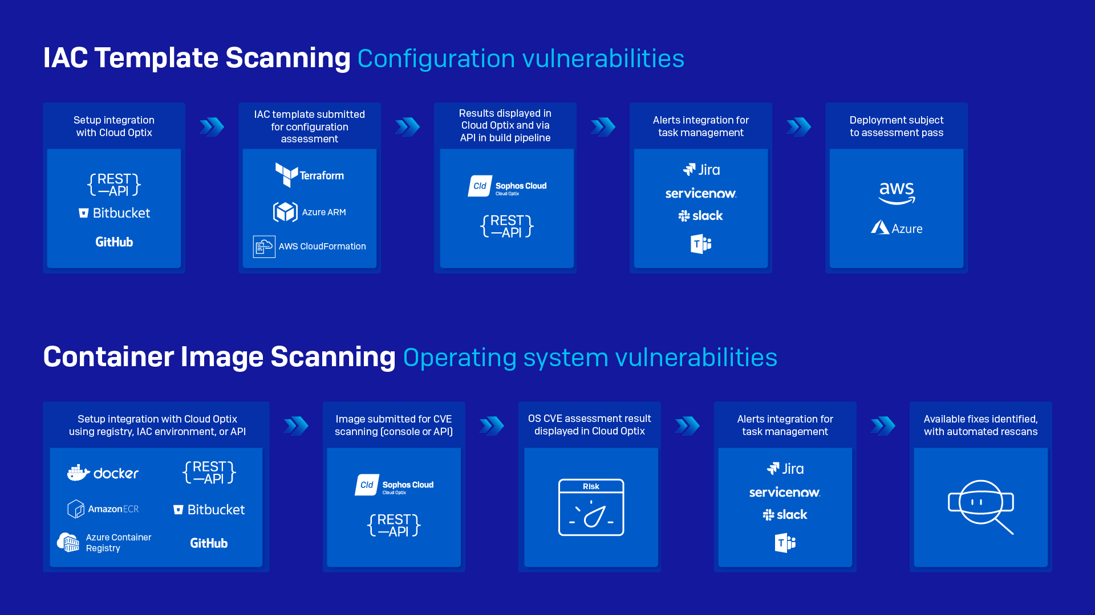
Security at the Pace of DevOps
Notes:
And now, our latest addition with - Container Image scanning
Allowing teams to prevent security breaches involving container image operating system vulnerabilities in….
Amazon Elastic Container Registries
Microsoft Azure Container Registries
Docker Hub registries
Infrastructure as Code environments
And Images in your build pipeline (using the Cloud Optix API)
This new capability of Cloud Optix is easy to setup, no additional license required as container images will count towards existing licensed assets, and there’s nothing to install.

Slide 27
How Cloud Optix Counts ‘Cloud Assets’
Definition: Cloud Asset means a single virtual machine instance, including any server instance or database instance, that runs in a Cloud Environment that benefits from, or whose configuration is accessed by, the service.
The following are currently counted as Cloud Assets:
AWS EC2
AWS RDS
Azure VM
Azure SQL Server
Azure DB Server
Google VM
Google SQL
Container Images
Kubernetes Nodes
To avoid duplication, K8s nodes are not counted if they are already counted as AWS EC2 VM / Azure VM / GCP VM
Note: This information is published in the Cloud Optix online help:
https://docs.Sophos.com/pcg/Optix/help/en-us/pcg/Optix/concepts/SophosCloudOptixLicensing.html
Notes:
And here you see a definition for Cloud Optix counts assets.
Cloud Asset means a single virtual machine instance, including any server instance or database instance, that runs in a Cloud Environment that benefits from, or whose configuration is accessed by, the service.
The following are currently counted as Cloud Assets:
AWS EC2
AWS RDS
Azure VM
Azure SQL Server
Azure DB Server
Google VM
Google SQL
Kubernetes Nodes
To avoid duplication, K8s nodes are not counted if they are already counted as AWS EC2 VM / Azure VM / GCP VM

Slide 28
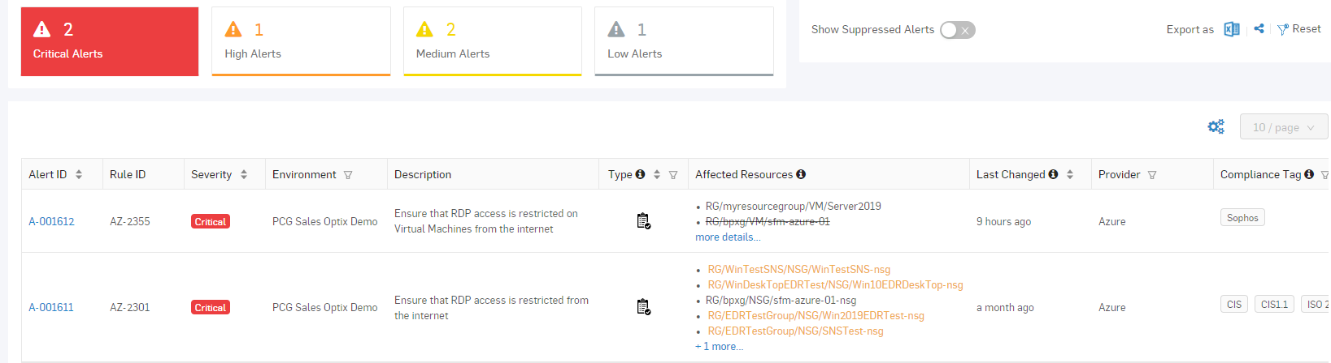
Brute Force Attacks
1
Exposing Remote Desktop Protocol (RDP)
89% of Organizations
Notes:
The first - Ensure that RDP access is restricted from the internet.
The potential security problem with using RDP over the Internet is that attackers can use various brute force techniques to gain access to Virtual Machines. Once the attackers gain access, they can use your virtual machine as a launch point for compromising other machines on your Virtual Network or even attack networked devices outside of your cloud provider.
But as you can see here, Cloud Optix continuous security scans will alert you to the issue, advise on the resources affected and provide you with detailed guided remediation steps to disable RDP.

Slide 29
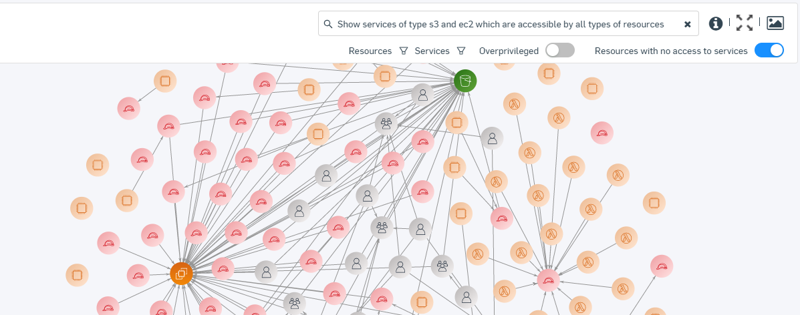
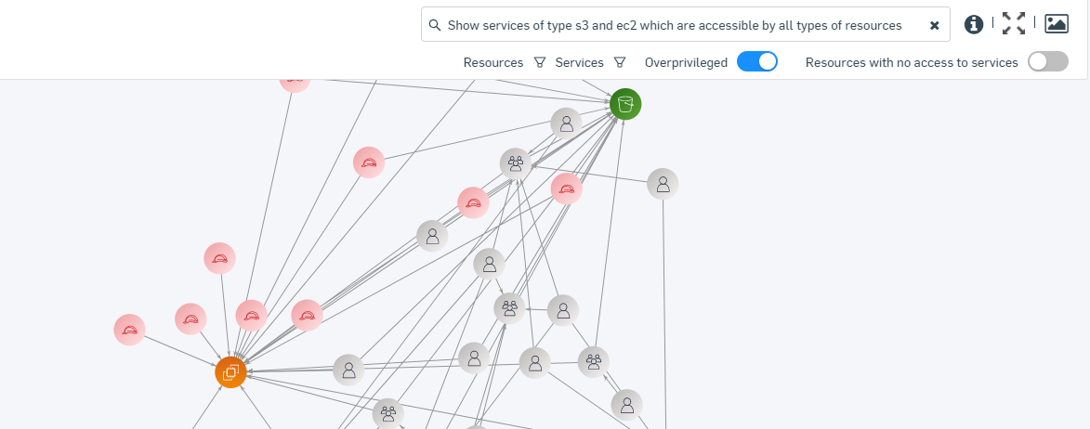
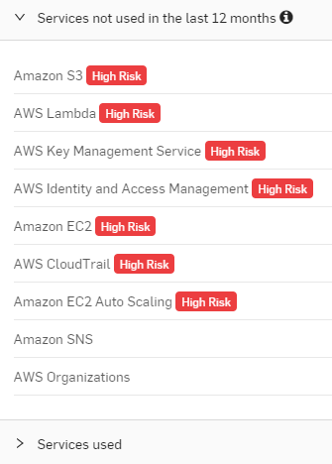
Manage IAM Roles Efficiently
2
Overprivileged
IAM roles
91% of Organizations
Notes:
Over-privileged IAM roles can also be avoided.
It’s all too common for new teammates in development or engineering to be setup with privileges they simply don’t need or use. Unfortunately as we saw in a high profile financial firms breach last year, those IAM roles and permissions can be used by criminals to move around compromised cloud accounts – think of it like lateral movement for access.
As you can see here, the good news is that Cloud Optix starts by visualizing those relationships between users, groups and services. Making it easy to make sense of interwoven nature of individual and group access to services.
(Click)
Then we can start to clean up this picture, stripping away resources with no access to services, and focus in on only those over-privileged roles.
(Click)
And then drilling into those roles we can identify the services not being accessed, and how they were granted to update IAM policies appropriately and follow the principle of least privilege.

